Slide 1


ITI- CMS Final project
20/5/2021

Slide 2
ITI- CMS Final project- Team #4
1-Ayman Mohamed Mostafa (Team Leader)
2-Mansour Ahmed Mansour
3-Somaya Mahmod Hassan
Project Supervisor
Eng. Noha Salah

Slide 3
outline
Introduction
Wordpress
Why Wordpress
Tools and Technologies
Website Structure
Project
References

Slide 4
Introduction
The aim of this project is to create a responsive and professional wordpress website for Jumia Company and the site of the company is: https://group.jumia.com/.

Slide 5
Wordpress
WordPress was initially released on 27th May, 2003 by Matt Mullenweg and Mike Little. WordPress was announced as open source in October 2009.
WordPress is an open source Content Management System (CMS), which allows the users to build dynamic websites and blogs.
Wordpress is the most popular blogging system on the web and allows updating, customizing and managing the website from its back-end CMS and components.

Slide 6
Why Wordpress
WordPress powers 40% of the internet in 2021, a growth of nearly 5% from 2020
If you count only the CMS-built sites, then 64.1% of them are WordPress – 4% growth from 2020.
Over 400 million people visit WordPress sites each month.
661 WordPress sites also pop up daily
There are over 58,000+ WordPress plugins that you can choose from.
There are more than 11,000 WordPress themes on ThemeForest.
It is very easy to edit the content as it uses WYSIWYG editor
Multilingual: available in 72 languages.
Over 36% of all WordPress sites are served over HTTPS.

Slide 7
Tools and Technologies
WordPress 5.7.2
PHP 7.4.8
Web server: Apache
MySQL Database
HTML
CSS

Slide 8
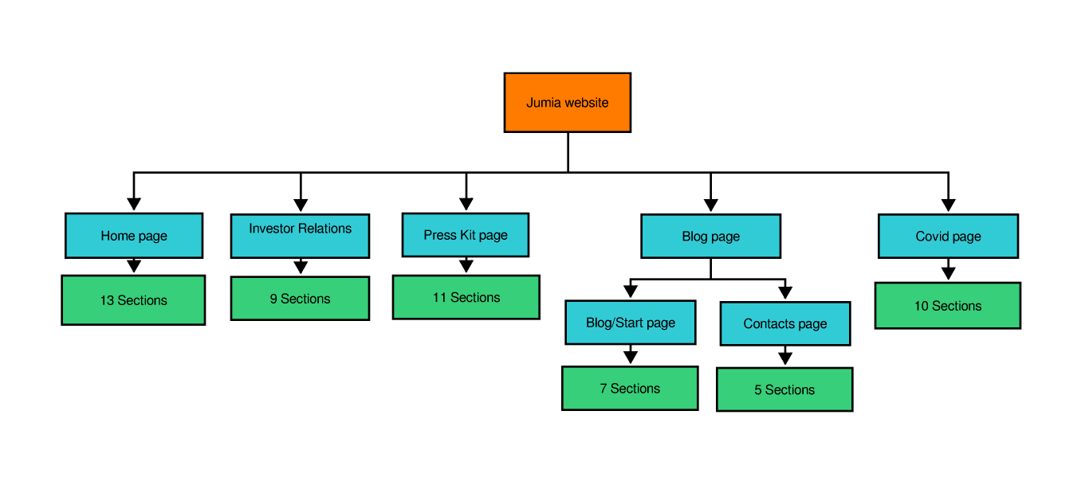
Website Structure

Slide 9
Project
Find free hosting website:https://infinityfree.net/
Choose a domain : http://itiproject.infinityfreeapp.com/
Install wordpress.
Choose Hello Elementor theme (we will build a website from scratch by Elementor pro page builder).
Install and activate plugins: Elementor, Elementor Pro, WP File Manager, and WPForms Lite.

Slide 10
References
https://hostingtribunal.com/blog/wordpress-statistics
https://kinsta.com/blog/wordpress-statistics/

Slide 11
Thank you

